Slide 1
System Structures
Operating Systems (CS-2006) Spring 2022, FAST NUCES
COURSE SUPERVISOR: ANAUM HAMID
anaum.hamid@nu.edu.pk

Slide 2
Roadmap
Operating-System Services
User Operating-System Interfaces
System Calls
Types of System Calls
System Programs
OS design and Implementation
Operating System Structures
System Debugging
System Generation
System Boot

Slide 3
Operating System Services
One set of operating-system services provides functions that are helpful to the user:
User interface - Almost all operating systems have a user interface (UI).
Varies between Command-Line (CLI), Graphics User Interface (GUI), Batch
Program execution - The system must be able to load a program into memory and to run that program, end execution, either normally or abnormally (indicating error)
I/O operations - The OS is responsible for transferring data to and from I/O devices, including keyboards, terminals, printers, and storage devices.

Slide 4
Operating System Services
File-system manipulation - The file system is of particular interest. Programs need to read and write files and directories, create and delete them, search them, list file Information, permission management.
Communications – Processes may exchange information, on the same computer or between computers over a network
Communications may be via shared memory or through message passing (packets moved by the OS).
Error detection – OS needs to be constantly aware of possible errors
May occur in the CPU and memory hardware, in I/O devices, in user program
For each type of error, OS should take the appropriate action
Notes:
In addition to raw data storage, the OS is also responsible for maintaining directory and subdirectory structures, mapping file names to specific blocks of data storage, and providing tools for navigating and utilizing the file system.

Slide 5
Operating System Services
Resource allocation - When multiple users or multiple jobs running concurrently, resources must be allocated to each of them
Many types of resources - CPU cycles, main memory, file storage, I/O devices.
E.g., CPU cycles, main memory, storage space, and peripheral devices. Some resources are managed with generic systems and others with very carefully designed and specially tuned systems, customized for a particular resource and operating environment.
Accounting - To keep track of which users use how much and what kinds of computer resources
Protection and security - The owners of information stored in a multiuser or networked computer system may want to control use of that information, concurrent processes should not interfere with each other
Protection involves ensuring that all access to system resources is controlled
Security of the system from outsiders requires user authentication, extends to defending external I/O devices from invalid access attempts

Slide 6
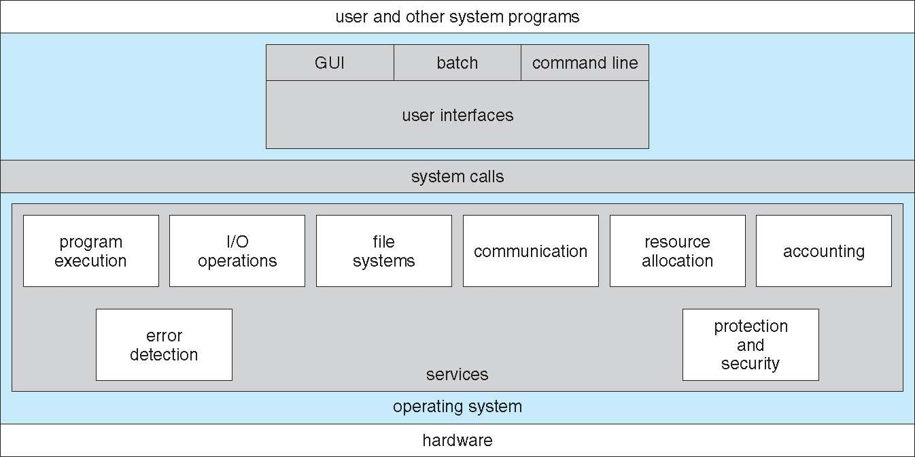
A View of Operating System Services

Slide 7
User Operating System Interface - CLI
CLI or command interpreter allows direct command entry
Sometimes multiple flavors implemented – shells
Primarily fetches a command from user and executes it
Sometimes commands built-in, sometimes just names of programs

Slide 8
User Operating System Interface - GUI
User-friendly desktop metaphor interface
Usually mouse, keyboard, and monitor
Icons represent files, programs, actions, etc
Various mouse buttons over objects in the interface cause various actions (provide information, options, execute function, open directory (known as a folder)
Many systems now include both CLI and GUI interfaces
Unix and Linux have CLI with optional GUI interfaces (CDE, KDE, GNOME)
Common Desktop Environment (CDE) – Unix based
K Desktop Environment (KDE) – Linux based
GNOME Unix variant

Slide 9
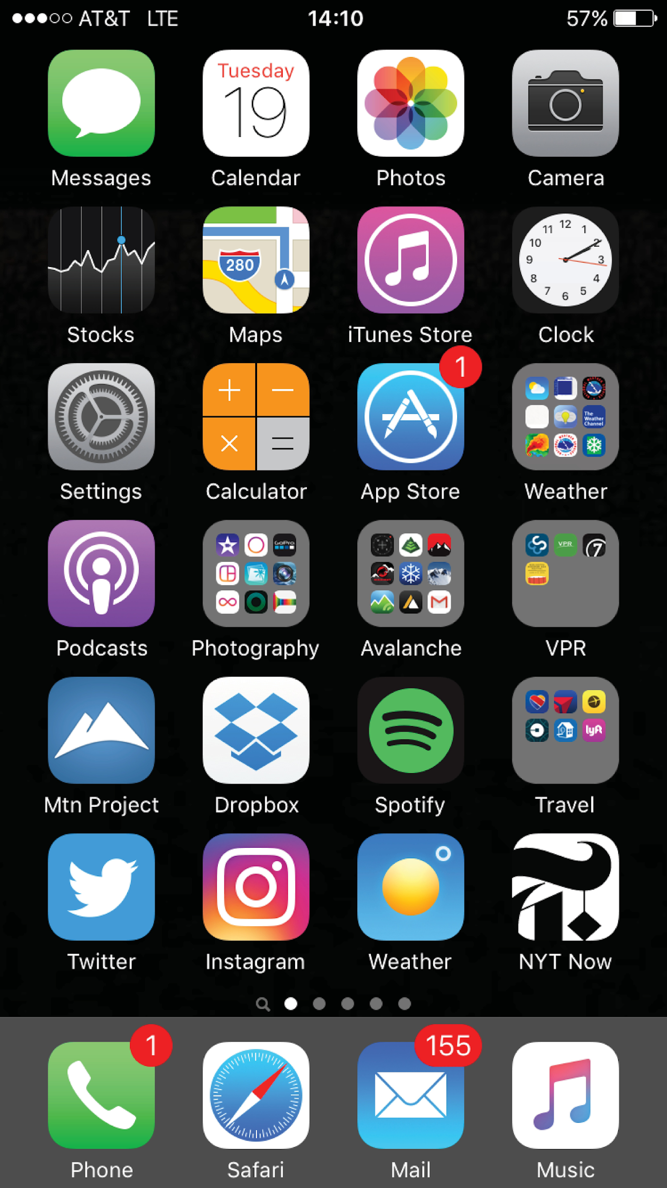
Touchscreen Interfaces
Touchscreen devices require new interfaces
Mouse not possible or not desired
Actions and selection based on gestures
Virtual keyboard for text entry
Voice commands.

Slide 10
The Mac OS X GUI

Slide 11
System Calls
A system call is a mechanism that provides the interface between a process and the operating system.
It is a programmatic method in which a computer program requests a service from the kernel of the OS.
System calls are the only entry points for the kernel system.
Programming interface to the services provided by the OS
Typically written in a high-level language (C or C++)
Mostly accessed by programs via a high-level Application Programming Interface (API) rather than direct system call use
Three most common APIs are Win32 API for Windows, POSIX API for POSIX-based systems (including virtually all versions of UNIX, Linux, and Mac OS X), and Java API for the Java virtual machine (JVM)

Slide 12
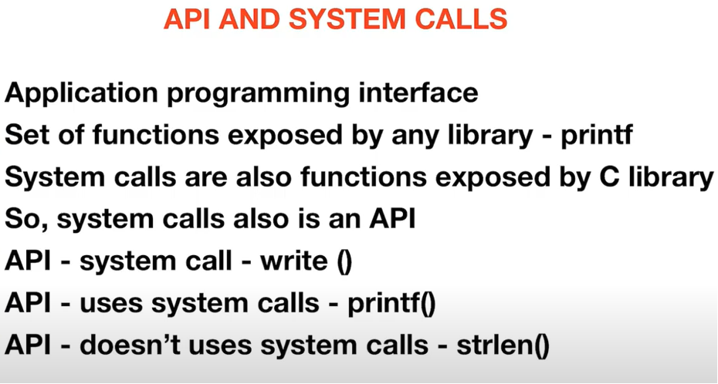

Slide 13
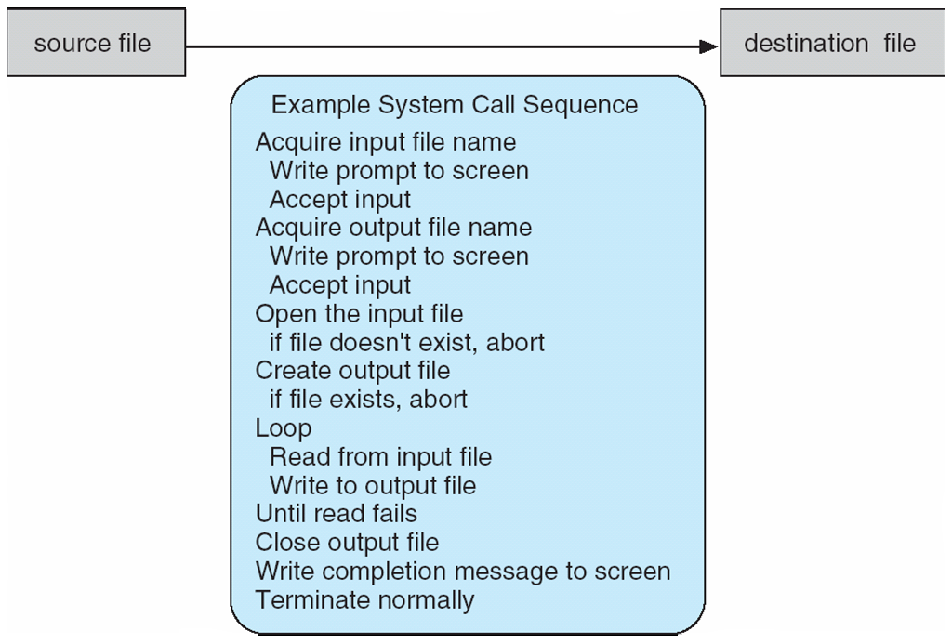
Example of System Calls
System call sequence to copy the contents of one file to another file

Slide 14
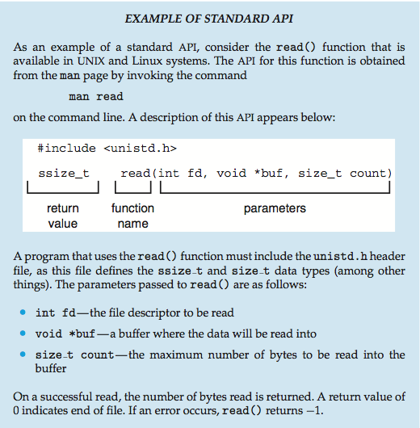
Example of Standard API

Slide 15
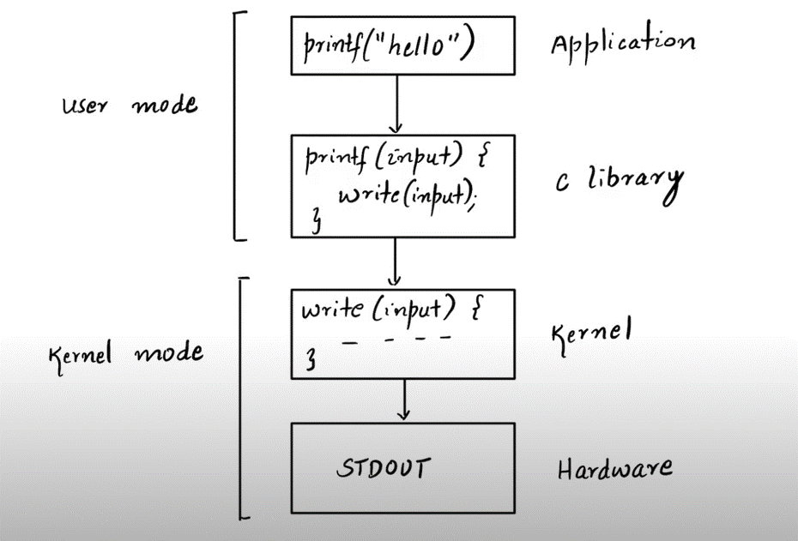

Slide 16
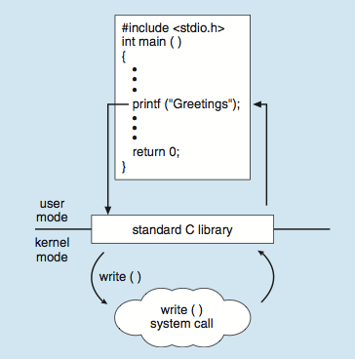
Standard C Library Example
C program invoking printf() library call, which calls write() system call

Slide 17
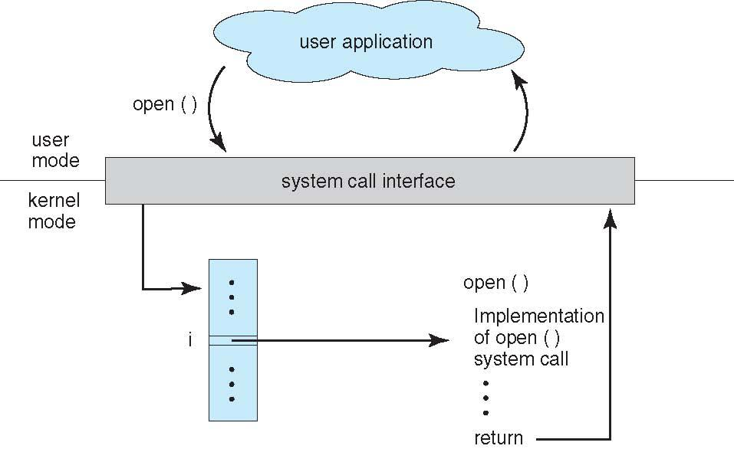
API – System Call – OS Relationship

Slide 18
System Call Parameter Passing
Three general methods used to pass parameters to the OS
Simplest: pass the parameters in registers
Parameters stored in a block, or table, in memory, and address of block passed as a parameter in a register
Parameters placed, or pushed, onto the stack by the program and popped off the stack by the operating system

Slide 19
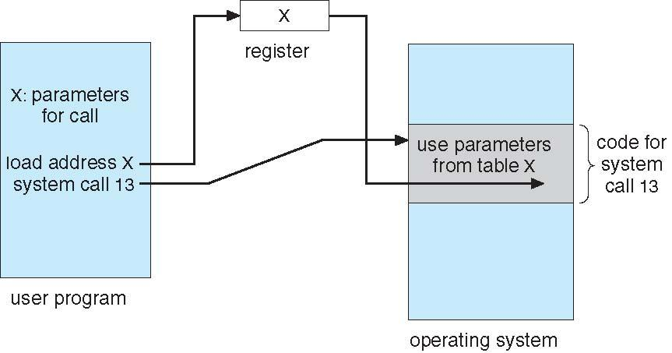
System Call Parameter Passing via Table

Slide 20
Types of System Calls
System calls can be roughly grouped into
five major categories:
Process Control
File management
Device Management
Information Maintenance
Communication
protection

Slide 21
Types of System Calls
1.Process Control
load
execute
create process (for example, fork on Unix-like systems or NtCreateProcess in the Windows NT Native API)
terminate process
get/set process attributes
wait for time, wait event, signal event
allocate free memory

Slide 22
Types of System Calls
2.File management
create file, delete file
open, close
read, write, reposition
get/set file attributes
3.Device Management
request device, release device
read, write, reposition
get/set device attributes
logically attach or detach devices

Slide 23
Types of System Calls
4.Information Maintenance
get/set time or date
get/set system data
get/set process, file, or device attributes
5.Communication
create, delete communication connection
send, receive messages
transfer status information
attach or detach remote device

Slide 24
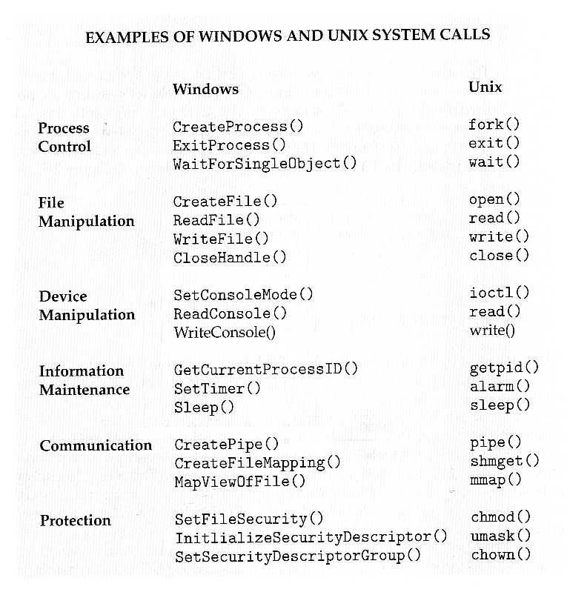

Slide 25
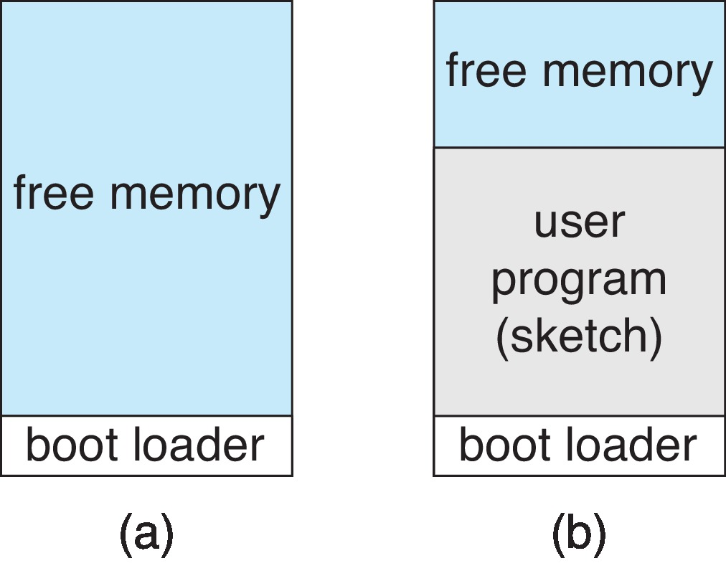
Example: Arduino
The Arduino is a simple hardware platform consisting of a microcontroller along with input sensors that respond to a variety of events, such as changes to light, temperature, and barometric pressure, etc.
Single-tasking
No operating system
Programs (sketch) loaded via USB into flash memory
Single memory space
Boot loader loads program
Program exit -> shell reloaded
At system startup running a program

Slide 26
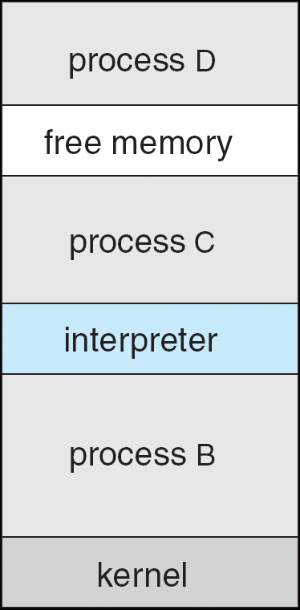
Example: FreeBSD (Berkeley Software Distribution)
Unix variant
Multitasking
User login -> invoke user’s choice of shell
Shell executes fork() system call to create process
Executes exec() to load program into process
Shell waits for process to terminate or continues with user commands
Process exits with:
code = 0 – no error
code > 0 – error code

Slide 27
System Programs
System programs provide a convenient environment for program development and execution. They can be divided into:
File manipulation
Status information
File modification
Programming language support
Program loading and execution
Communications
Background services
Application programs

Slide 28
System Programs
File management - Create, delete, copy, rename, print, dump, list, and generally manipulate files and directories
Status information
Some ask the system for info - date, time, amount of available memory, disk space, number of users
Others provide detailed performance, logging, and debugging information

Slide 29
System Programs (Cont.)
File modification
Text editors to create and modify files
Special commands to search contents of files or perform transformations of the text
Programming-language support - Compilers, assemblers, debuggers and interpreters sometimes provided
Program loading and execution- debugging systems for higher-level and machine language
Communications - Provide the mechanism for creating virtual connections among processes, users, and computer systems

Slide 30
System Programs (Cont.)
Background Services
Launch at boot time
Provide facilities like disk checking, process scheduling, error logging, printing
Run in user context not kernel context
Known as services, subsystems, daemons
Application programs
Run by users

Slide 31
Linkers and Loaders
Source code compiled into object files designed to be loaded into any physical memory location – relocatable object file
Linker combines these into single binary executable file
Also brings in libraries
Program resides on secondary storage as binary executable
Must be brought into memory by loader to be executed
Relocation assigns final addresses to program parts and adjusts code and data in program to match those addresses
Modern general-purpose systems don’t link libraries into executables
Rather, dynamically linked libraries (in Windows, DLLs) are loaded as needed, shared by all that use the same version of that same library (loaded once)
Object, executable files have standard formats, so operating system knows how to load and start them

Slide 32
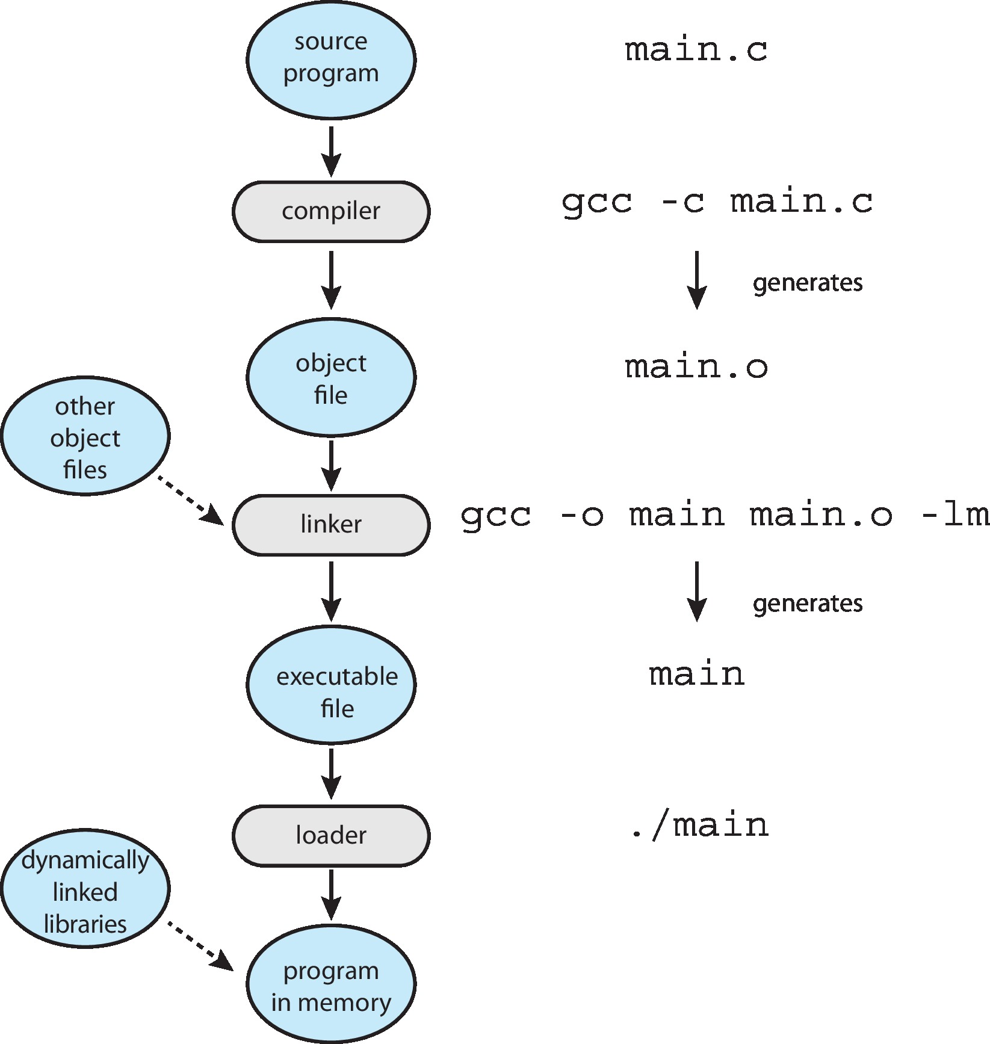
The Role of the Linker and Loader

Slide 33
Why Applications are Operating System Specific
Apps compiled on one system usually not executable on other operating systems
Each operating system provides its own unique system calls
Own file formats, etc.
Apps can be multi-operating system
Written in interpreted language like Python, Ruby, and interpreter available on multiple operating systems
App written in language that includes a VM containing the running app (like Java)
Use standard language (like C), compile separately on each operating system to run on each
Application Binary Interface (ABI) is architecture equivalent of API, defines how different components of binary code can interface for a given operating system on a given architecture, CPU, etc.

Slide 34
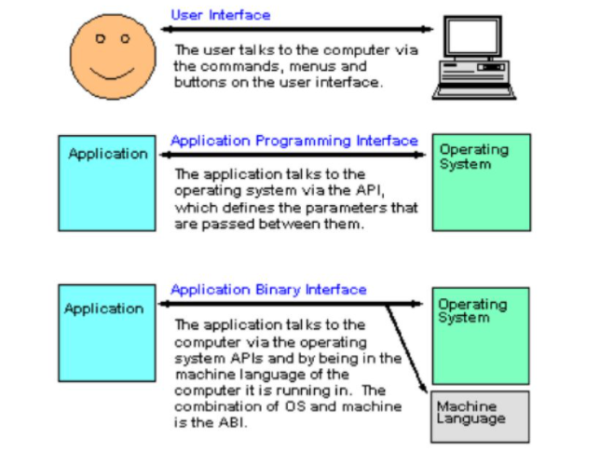
GUI vs API vs ABI

Slide 35
Operating System Design and Implementation
Start the design by defining goals and specifications
Affected by choice of hardware, type of system
User goals and System goals
User goals – operating system should be convenient to use, easy to learn, reliable, safe, and fast
System goals – operating system should be easy to design, implement, and maintain, as well as flexible, reliable, error-free, and efficient

Slide 36
Implementation
Much variation
Early OSes in assembly language
Then system programming languages like Algol, PL/1
Now C, C++
Usually, a mix of languages
Lowest levels in assembly
Main body in C
Systems programs in C, C++, scripting languages like PERL, Python, shell scripts
More high-level language easier to port to other hardware
But slower
Emulation can allow an OS to run on non-native hardware

Slide 37
Operating System Design and Implementation (Cont.)
Important principle to separate
Policy: What will be done? Mechanism: How to do it?
Mechanisms determine how to do something; policies decide what will be done
The separation of policy from mechanism is a very important principle, it allows maximum flexibility if policy decisions are to be changed later (example – timer)

Slide 38
Operating System Structure
There are six different structures:
Simple Structure
Monolithic Structures
Layered Systems
Micro kernels
Modules
Hybrid Machines

Slide 39
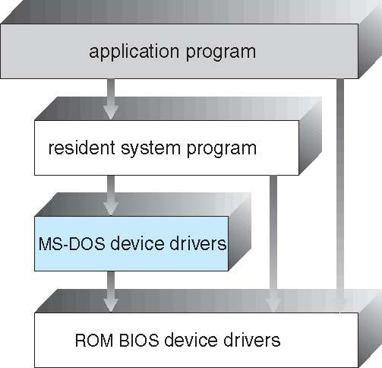
Simple Structure -- MS-DOS
MS-DOS – written to provide the most functionality in the least space
Not divided into modules
Although MS-DOS has some structure, its interfaces and levels of functionality are not well separated

Slide 40
Monolithic Structure -- UNIX
UNIX – limited by hardware functionality, the original UNIX operating system had limited structuring. The UNIX OS consists of two separable parts
Systems programs
The kernel
Consists of everything below the system-call interface and above the physical hardware
Provides the file system, CPU scheduling, memory management, and other operating-system functions; many functions for one level

Slide 41
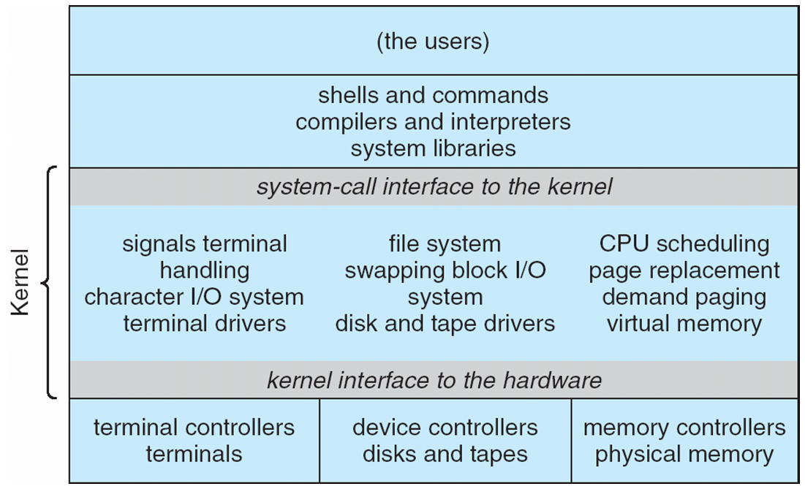
Traditional UNIX System Structure
Beyond simple but not fully layered

Slide 42
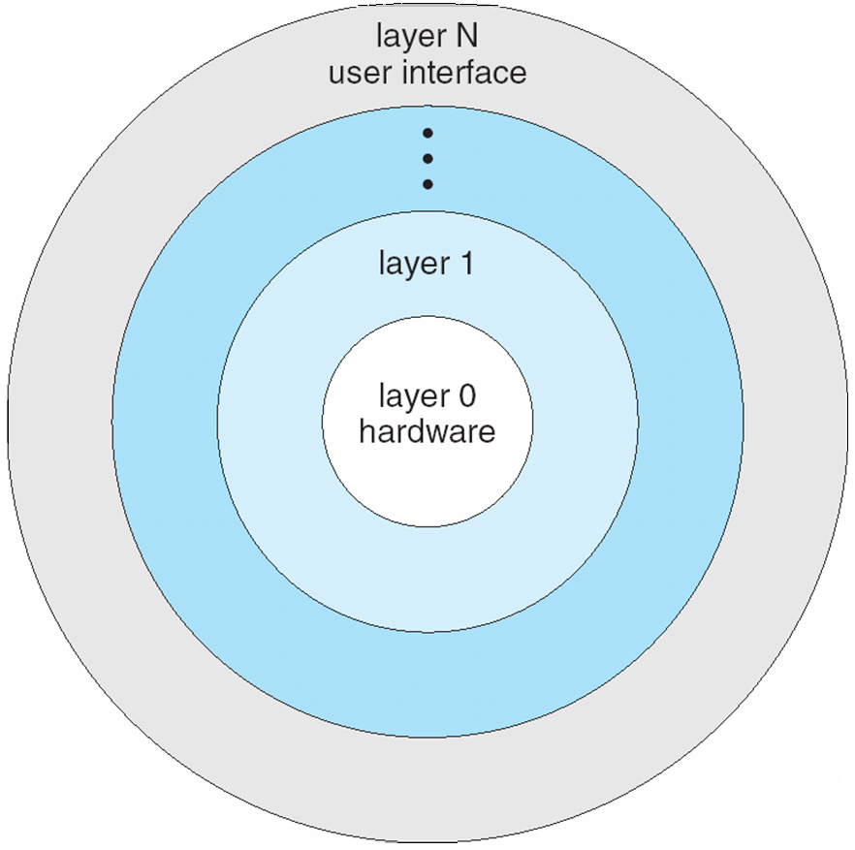
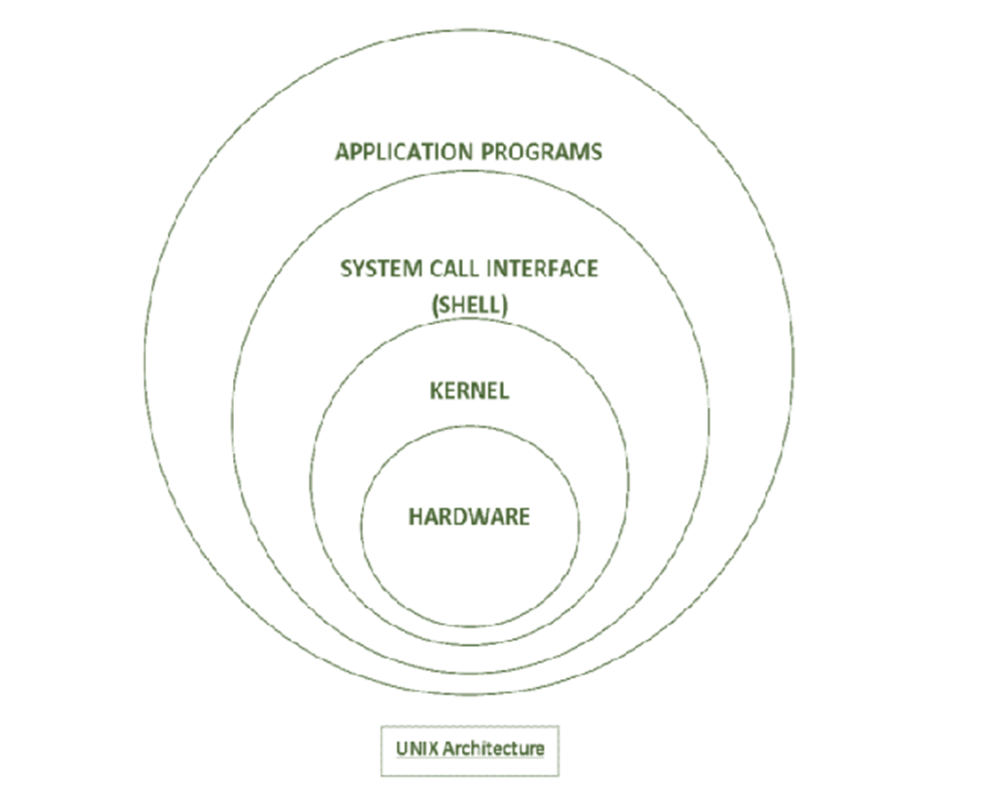
Layered Approach
The operating system is divided into several layers (levels), each built on top of lower layers. The bottom layer (layer 0), is the hardware; the highest (layer N) is the user interface.
With modularity, layers are selected such that each uses functions (operations) and services of only lower-level layers

Slide 43
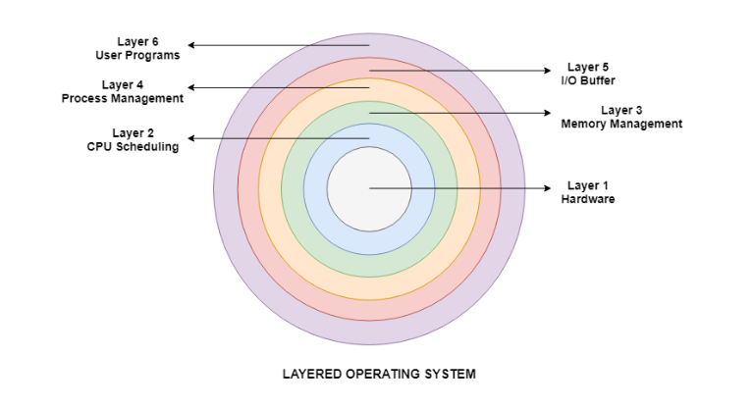
Layered Approach

Slide 44
Microkernel System Structure
Moves as much from the kernel into user space
Mach example of microkernel
Mac OS X kernel (Darwin) partly based on Mach
Communication takes place between user modules using message passing
Benefits:
Easier to extend a microkernel
Easier to port the operating system to new architectures
More reliable (less code is running in kernel mode)
More secure
Detriments:
Performance overhead of user space to kernel space communication

Slide 45
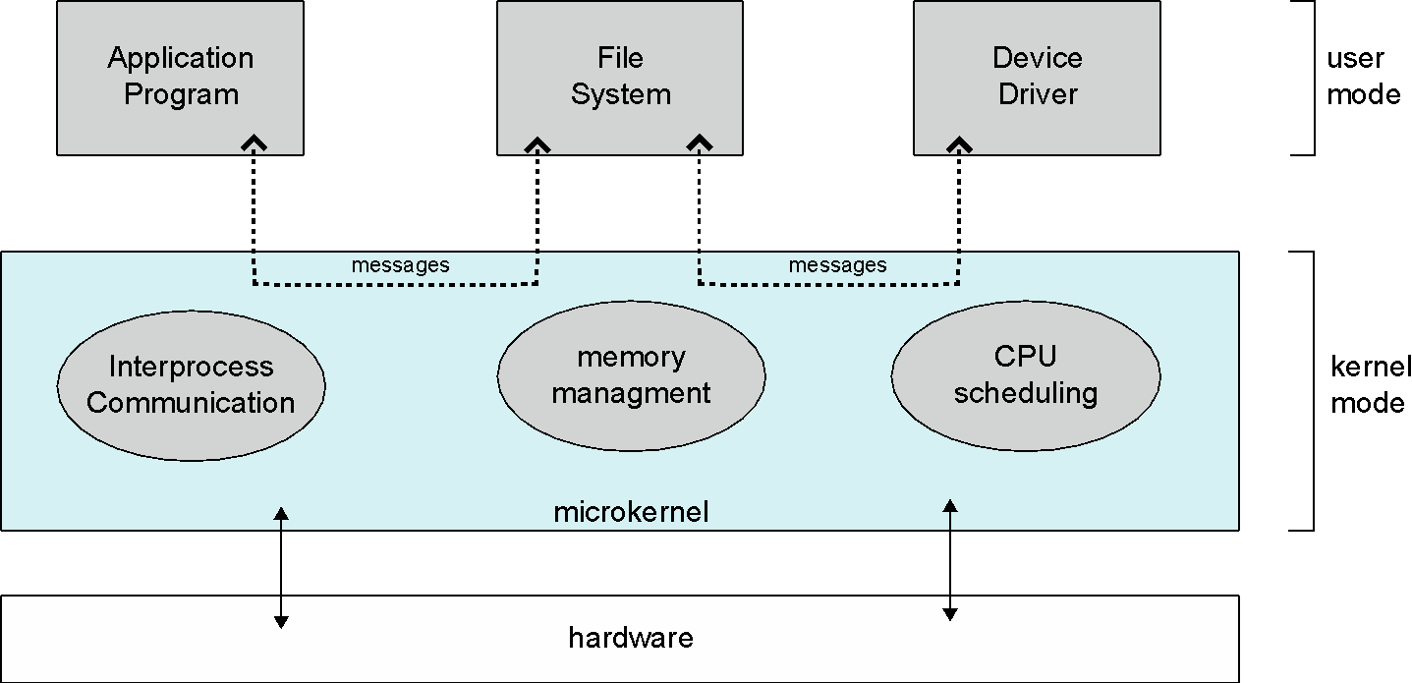
Microkernel System Structure

Slide 46
Modules
Many modern operating systems implement loadable kernel modules
Uses object-oriented approach
Each core component is separate
Each talks to the others over known interfaces
Each is loadable as needed within the kernel
Overall, like layers but with more flexible
Linux, Solaris, etc

Slide 47
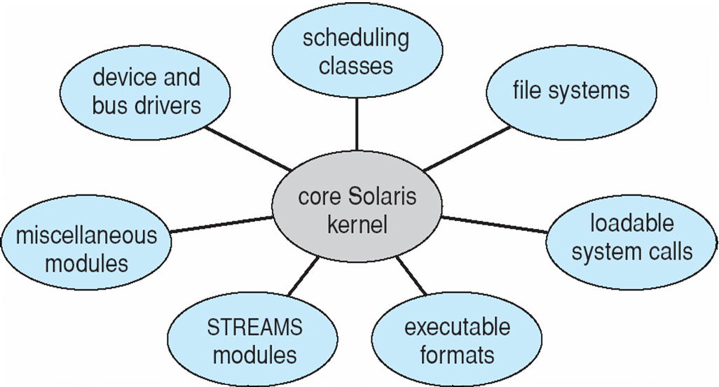
Solaris Modular Approach

Slide 48
Hybrid Systems
Most modern operating systems are not one pure model
Hybrid combines multiple approaches to address performance, security, usability needs
Linux and Solaris kernels in kernel address space, so monolithic, plus modular for dynamic loading of functionality
Windows mostly monolithic, plus microkernel for different subsystem personalities
Apple Mac OS X hybrid, layered, Aqua UI plus Cocoa programming environment
Below is kernel consisting of Mach microkernel and BSD Unix parts, plus I/O kit and dynamically loadable modules (called kernel extensions)

Slide 49
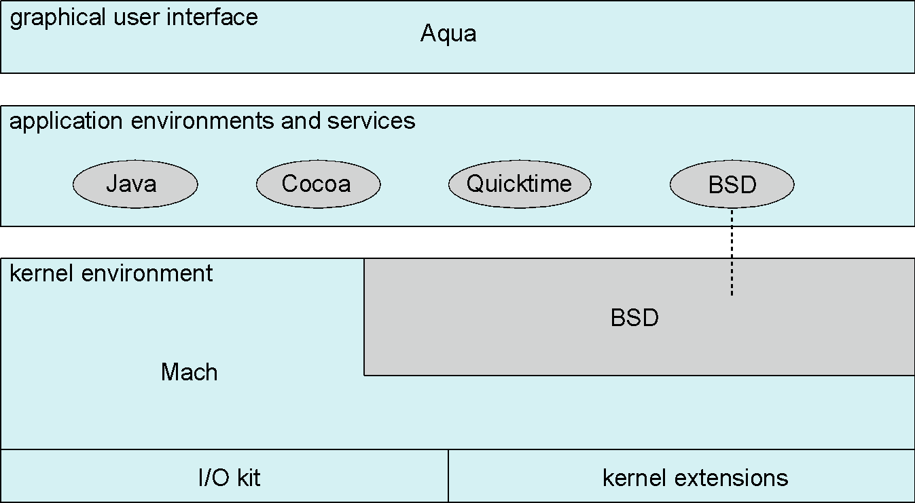
Mac OS X Structure

Slide 50
Android
Developed by Open Handset Alliance (mostly Google)
Open Source
Similar stack to IOS
Based on Linux kernel but modified
Provides process, memory, device-driver management
Adds power management
Runtime environment includes core set of libraries and Dalvik virtual machine
Apps developed in Java plus Android API
Java class files compiled to Java bytecode then translated to executable than runs in Dalvik VM
Libraries include frameworks for web browser (webkit), database (SQLite), multimedia, smaller libc

Slide 51
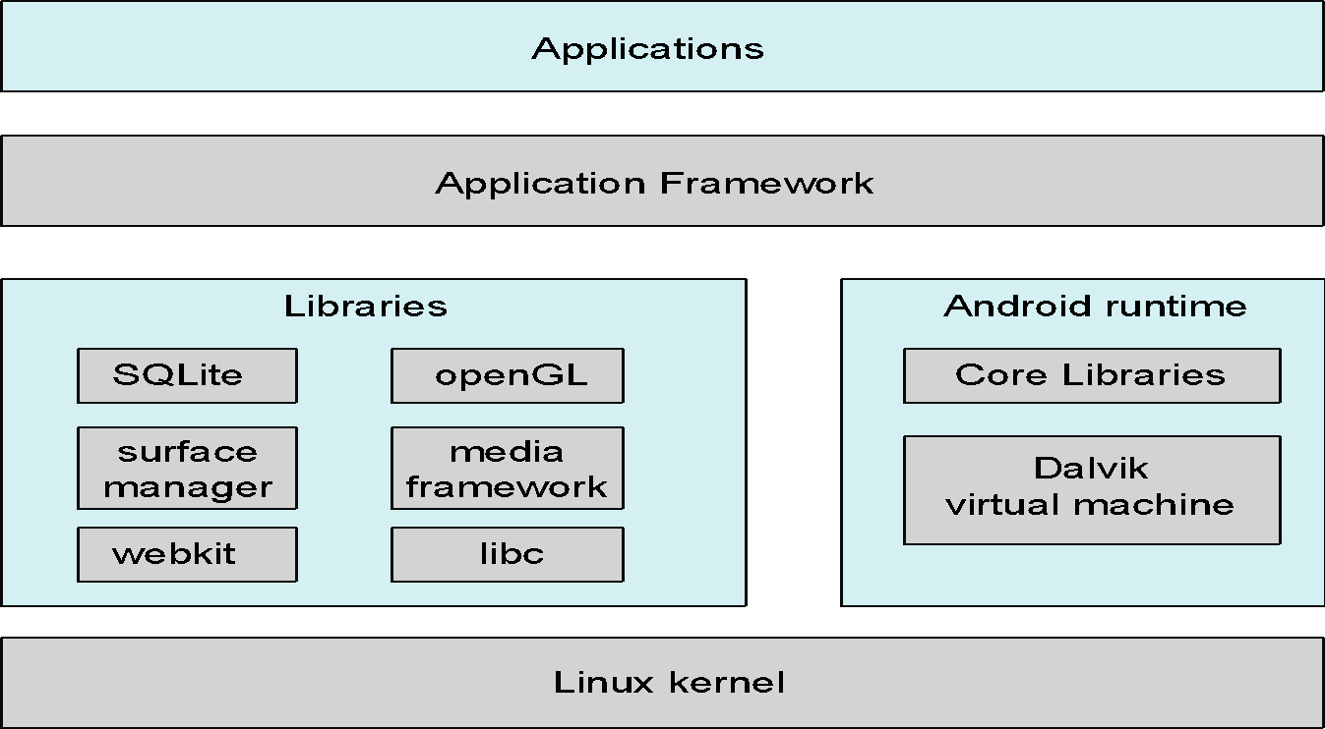
Android Architecture

Slide 52
Operating-System Debugging
Debugging is finding and fixing errors, or bugs
OS generate log files containing error information
Failure of an application can generate core dump file capturing memory of the process
Operating system failure can generate crash dump file containing kernel memory
Beyond crashes, performance tuning can optimize system performance
Sometimes using trace listings of activities, recorded for analysis
Profiling is periodic sampling of instruction pointer to look for statistical trends
Kernighan’s Law: “Debugging is twice as hard as writing the code in the first place. Therefore, if you write the code as cleverly as possible, you are, by definition, not smart enough to debug it.”

Slide 53
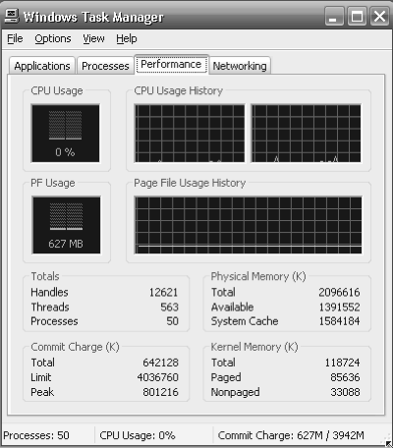
Performance Tuning
Improve performance by removing bottlenecks
OS must provide means of computing and displaying measures of system behavior
For example, “top” program or Windows Task Manager

Slide 54
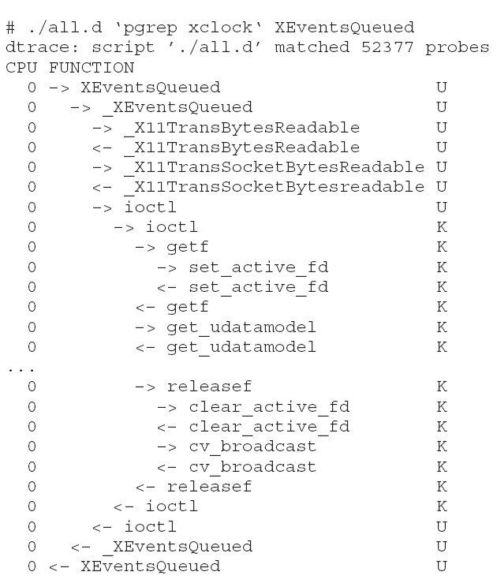
DTrace
DTrace tool in Solaris, FreeBSD, Mac OS X allows live instrumentation on production systems.
DTrace code to record amount of time each process with UserID 101 is in running mode (on CPU) in nanoseconds

Slide 55
Operating System Generation
Operating systems are designed to run on any of a class of machines; the system must be configured for each specific computer site

Slide 56
SYSGEN
Information that is needed to configure an OS include:
What CPU(s) are installed on the system, and what optional characteristics does each have?
How much RAM is installed?
What devices are present? The OS needs to determine which device drivers to include, as well as some device-specific characteristics and parameters.
What OS options are desired, and what values to set for OS parameters.

Slide 57
System Boot
When power initialized on system, execution starts at a fixed memory location
Firmware ROM used to hold initial boot code
Operating system must be made available to hardware so hardware can start it
Small piece of code – bootstrap loader, stored in ROM or EEPROM locates the kernel, loads it into memory, and starts it
Sometimes two-step process where boot block at fixed location loaded by ROM code, which loads bootstrap loader from disk
Common bootstrap loader, GRUB, allows selection of kernel from multiple disks, versions, kernel options
Kernel loads and system is then running

Slide 58
Thank You! Chapter 2 Completed

